Slide 1
1920 - Music
Also know as:
the “Jazz Age”
the Golden Twenties
the Roaring Twenties

Slide 2
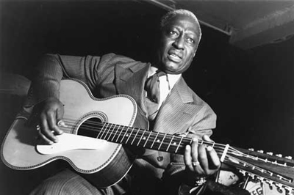
History and background
Jazz became a really popular music genre in America.
Jazz’ birthplace is in New Orleans
Its rise in popularity.

Slide 3
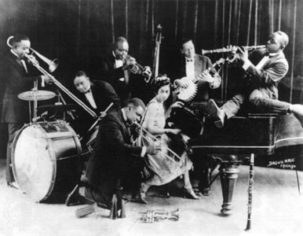
Jazz bands typically consisted of seven to twelve musicians.
The "potter palms" concert and big-band jazz performances.
In the early years of jazz.

Slide 4
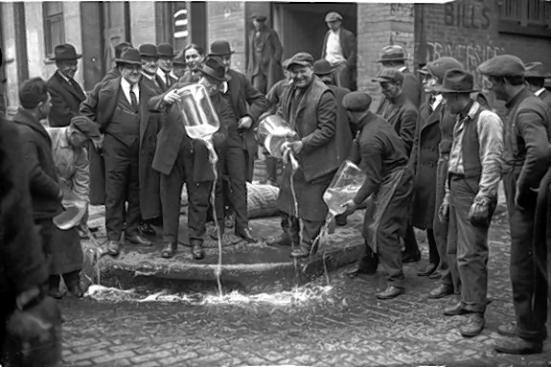
Prohibition
the Eighteenth Amendment
Illegal drinking.
Owners of clubs competed by hiring the best entertainers they could afford, including jazz musicians.

Slide 5
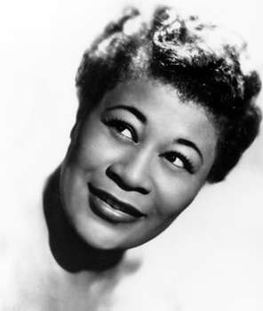
Popular Artists
Ella Fitzgerald (1917–96)
Dinah Washington (1924-63)
Sarah Vaughan (1924–90)
Scott Joplin (1868–1917)
Charles “Buddy” Bolden (1877–1931)
Duke Ellington (1899–1974)
Louis Armstrong (1901–71)
Joe Venuti (1903–78)
Earl Hines (1903–83)

Slide 6
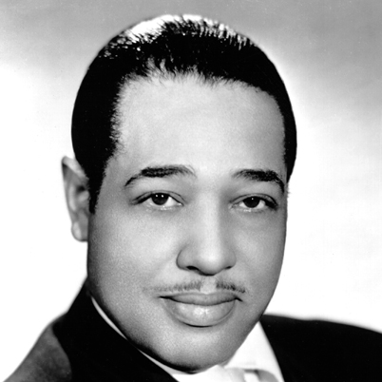
Duke Ellington (1899-1974)
Pianist, arranger, songwriter, bandleader, and producer.

